Slide 1
Requirements and design of Social Media for T&M
By Zach Christensen

Slide 2
Idea
An image board where people can post anonymously and ask questions to get support with the Theseus and Minotaur game.
A post created by a user can have any of the following
A post number (auto generated) (Every post will have one)
A timestamp (auto generated) (Every post will have one)
A title (optional)
A name (optional)
A body of text (optional)*
An image (optional)*
*must have 1 of.
Users can create threads (new threads must contain an image and a title)

Slide 3
Moscow requirement prioritisation method
Must haves:
The user can create a thread
While creating a thread the following fields will be available for them to add information to:
Subject
Name
Comment
Optional file upload for images
The user must have an image, a subject and a comment in order to post.
While replying to a thread a user will be able to have a:
Subject
Name
Comment
Optional image
When replying to a thread a post must at least have either a comment or an image
All posts (including the ones that start threads) made will have a post number (for the site, not thread) and a timestamp generated server side and displayed on the page when looking at posts.

Slide 4
Moscow requirement prioritisation method
Must haves (part two):
Each post must also
Image filenames are displayed on posts with an image.
Images are displayed smaller on the page than their full size
clicking the filename will open it in a new tab (as an image not webpage)
On the “homepage” you will be able to see the last 5 threads to be posted in with:
The first post
The last 5 posts made in that thread
These will be displayed as they would be normally in a webpage for that thread but only with 5 posts
If the user does not submit a name with their post they will be called “Anonymous”
The site should defend against basic xss attacks

Slide 5
Moscow requirement prioritisation method
Should haves:
Clicking on an image expands it to fit the screen(or its actual size if its not as big as the screen)
Support for animated gifs
The threads are on different pages if there are too many for one page. (5 per page on thread viewer)
A search function that returns recent threads/posts with the words searched for
A news area on the main page that links to the most recent 4 news stories( e.g. information about how the site is changing) and has the dates of when they were posted

Slide 6
Moscow requirement prioritisation method
Could haves:
Multiple boards (Term used on imageboards meaning a sub-forum type of structure with each board being for discussing different topics)
Default styles for the different boards. (images on the sides of the page and a different colour scheme)
Reply functionality which would allow people to link to other messages.
Support for soundless webms (common animated gif replacement recently, video container)
Style Chooser which changes the css and look of the page
The ability to delete posts by putting a password in when submitting posts and then being able to select
Ability for moderators to lock threads which would prevent people from posting in them anymore

Slide 7
Moscow requirement prioritisation method
Will not haves:
Video upload
Flash animation upload
Anything else upload
A log in (for normal users)(Moderators need to log in the change news stories and delete posts.)

Slide 8
Behat
Behat FEATURE requirements and SCENARIOS
Feature: User posts to a thread
Scenario: User wants to post to a thread
Given they are on that page
And have any image they could need on their computer
When the user fills in all the information they want to
And have added either an image or some text to the main text box
And the user clicks “Submit”
Then that information will be sent to the server
And when the page is reloaded the new post will be there

Slide 9
Behat
Behat FEATURE requirements and SCENARIOS
Feature: User creates a thread
Scenario: User wants to post a thread
Given the user is on the main page for that board
And have any image they could need on their computer
When they click the new thread button they are taken to the new thread page
And when they have added either an image or some text to the main text box and a subject
And the user clicks “Submit”
Then that information will be sent to the server
And when the board’s main page is reloaded the new post will be there at the top because it is the most recently posted in thread.

Slide 10

Behat
Behat FEATURE requirements and SCENARIOS
Feature: News Article Creation
Scenario: Moderator would like to create a new news article
Given the moderator is currently signed in
When they click the new news button on the news page
And when they write the article
And the user clicks “Submit”
Then that information will be sent to the server
And the server will create information such as the time of creation and newsID automatically
And when the news page is reloaded the new article can then be seen

Slide 11
Behat
Behat FEATURE requirements and SCENARIOS
Feature: Lock thread
Scenario: Moderator would like to lock a thread
Given the moderator is currently signed in
When are viewing a thread
And click lock thread button
And click the ok prompt that appears to check if they meant to do that
Then the thread will be locked an no one can post in it anymore

Slide 12
Behat
Behat FEATURE requirements and SCENARIOS
Feature: Change Style
Scenario: User will change the style
Given The user is on a page
When the user navigates to the drop down style box and clicks it
And clicks the new style they want
Then style of the website will be changed (different css changed by a php variable)

Slide 13
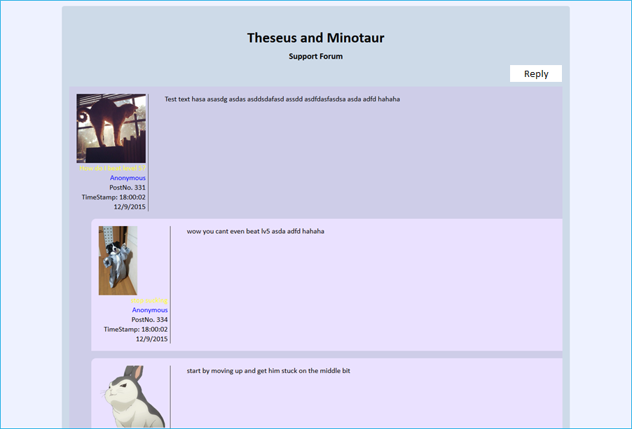
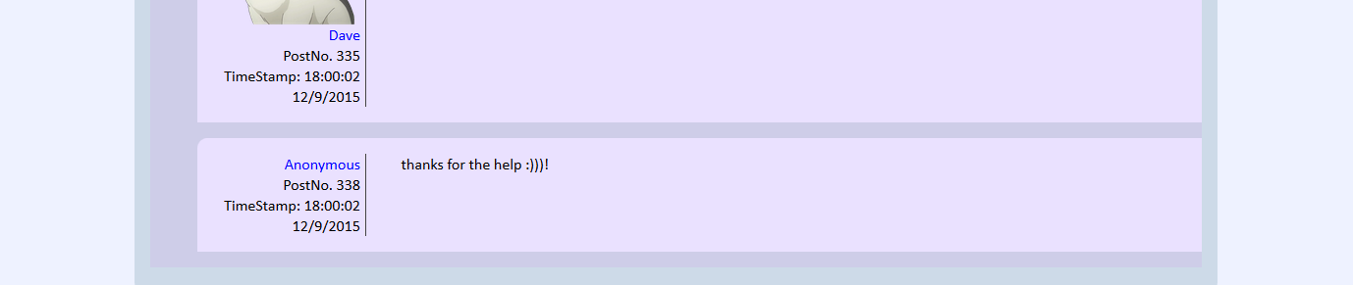
Mock html
This design is not totally final, I expect a few minor changes will be made in the final version but it gives a good idea of what the final product will look like.
This is what a webpage will look of one thread.
Reply button takes you to a reply creation page.
In the final version the images will be centred unlike how the dog is here.
The homepage that shows many threads looks the same but has many threads on the same page with only the 56 most recent posts

Slide 14
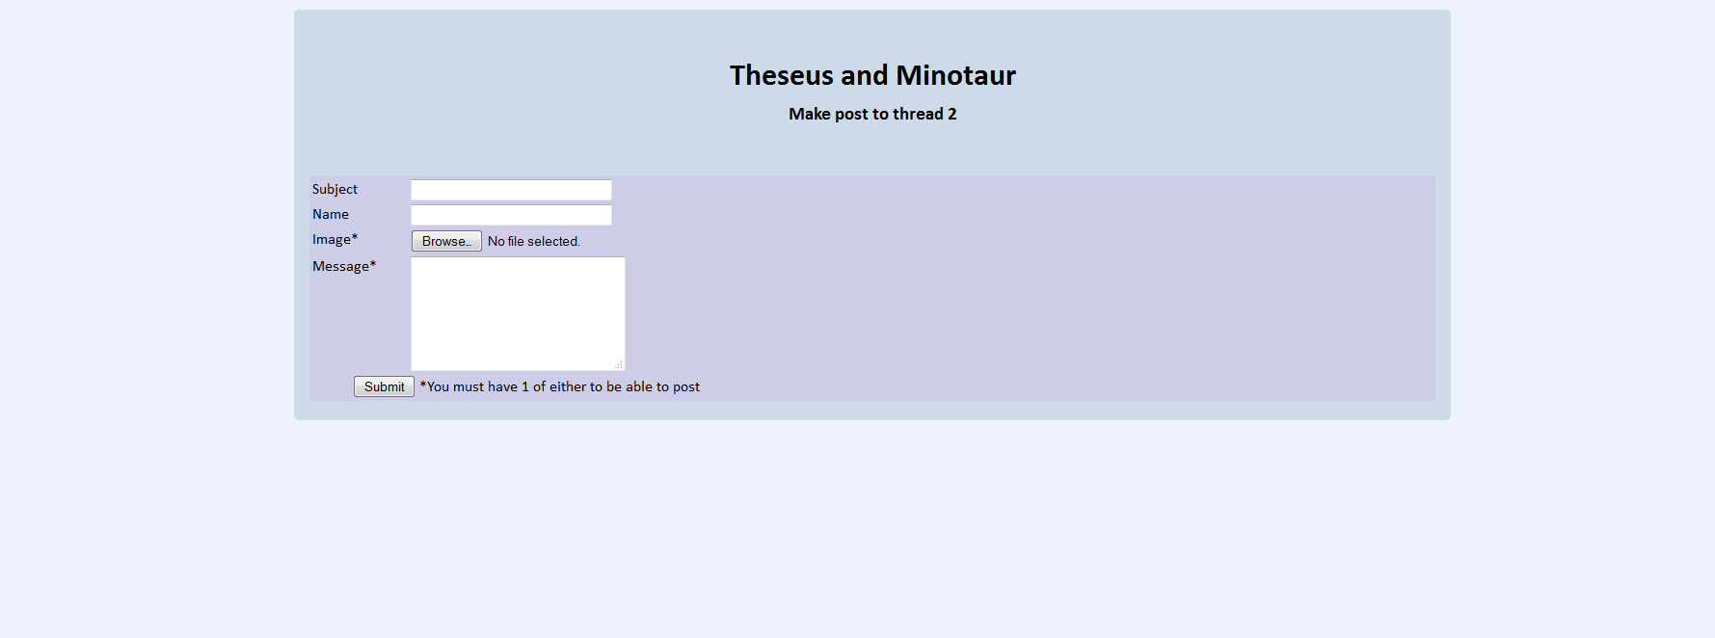
Mock HTML forms
This is my mock HTML for when the user replies to a thread.
The create thread screen is super similar.

Slide 15
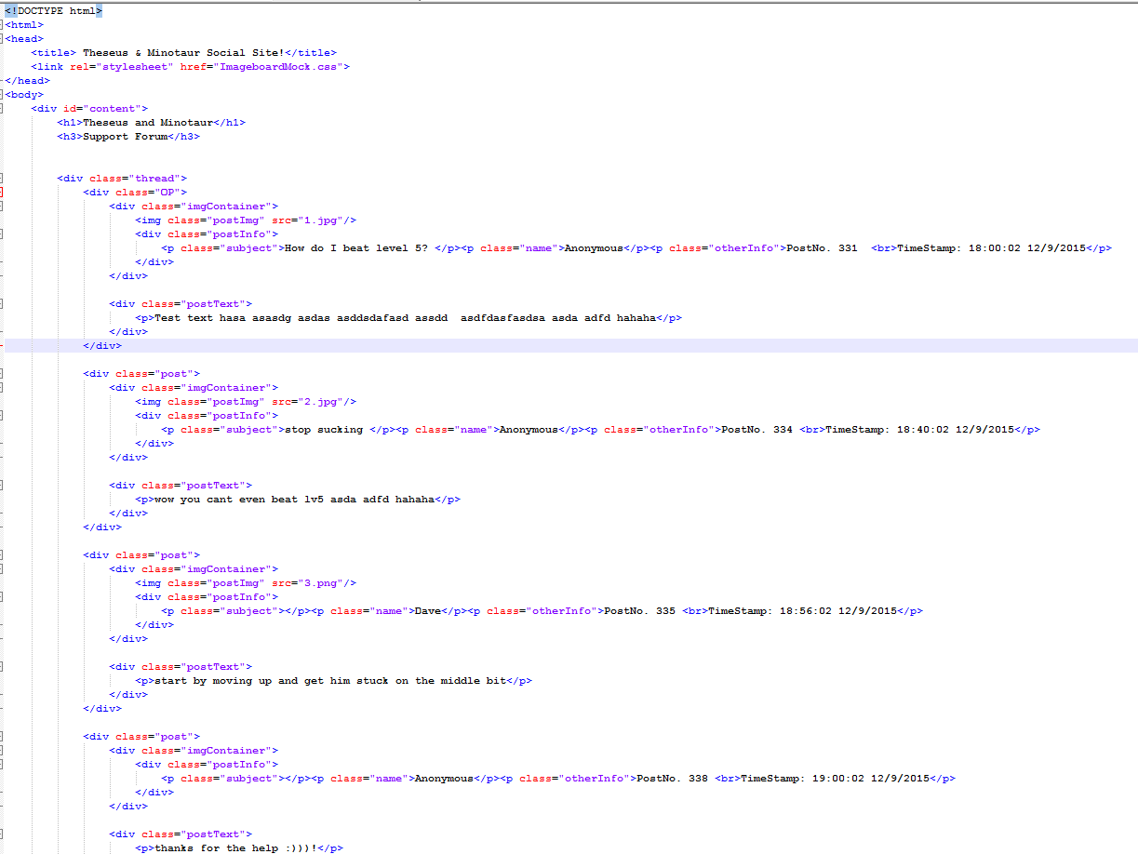
The html code
Here is what the html looks like for a thread view

Slide 16
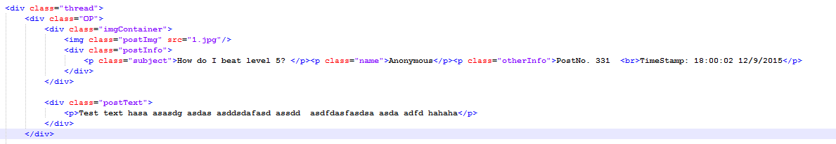
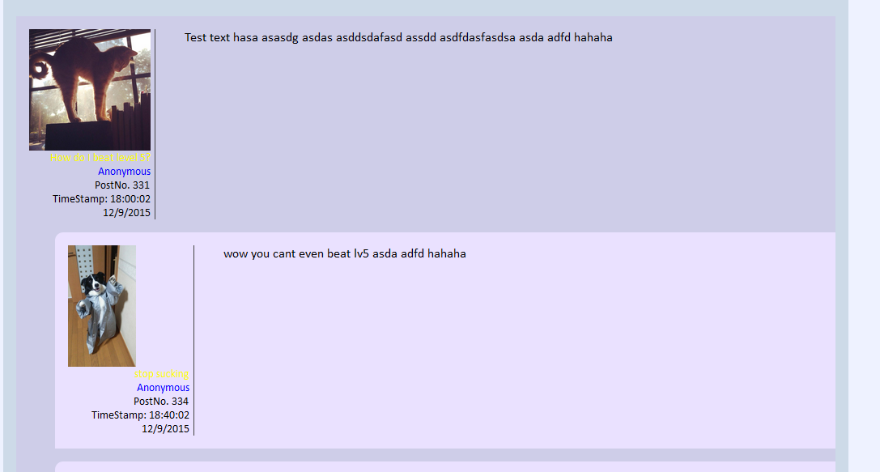
The html code Breakdown
To the right is what the start of the thread looks like the html for the first post in a thread is different to make it stand out from the others and give the impression that the other posts are replying to it and are not of equally important. Subject and name have different classes than the rest of the post info so they can look different on the page due to css

Slide 17
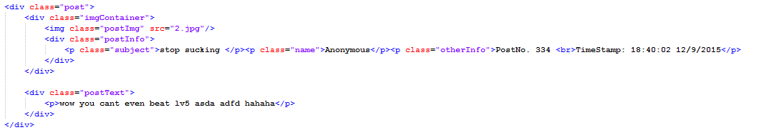
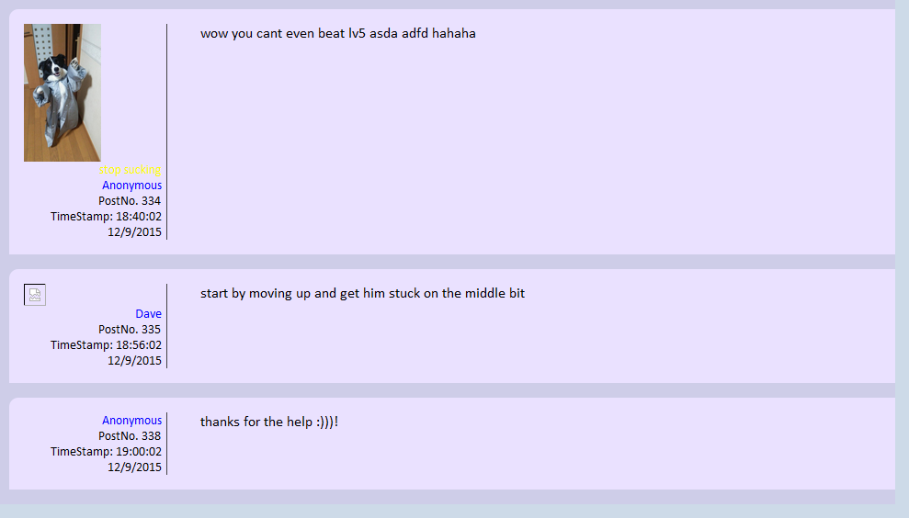
The html code Breakdown 2
To the right of this is what a post looks like in html every post in a thread has the same.
The html used for the posts is always the same except for images. When there is no image the php that is adding posts to the page will not add a <img> tag to prevent broken links like on the right.
When there are no subject the area it would normally take up is empty and it shows nothing.
The css for the posts is currently not perfect and has a small problem with resizing horizontally however this will be fixed in the final version.

Slide 18
The colour scheme
I have gone for a light blue and purple colour theme. I chose the colours by using Adobe Kuler and finding a colour I liked and the complementary colours for it were used as the other colours. I have not given much thought to the potential extra themes that I might implement if I have extra time however one of them will be a dark theme.
Page colour
Main section
Thread/Form Colour
Post Colour

Slide 19
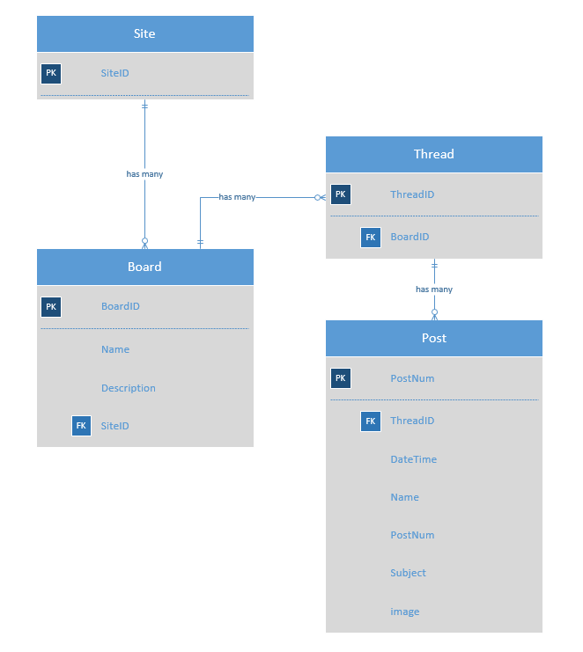
Entity relationship diagram 1
It is important to note that the post that starts a thread is just the a post in the thread and the things posted to start the thread are just another post
This is what the diagram would look like if only the minimum requirements were met during development.

Slide 20
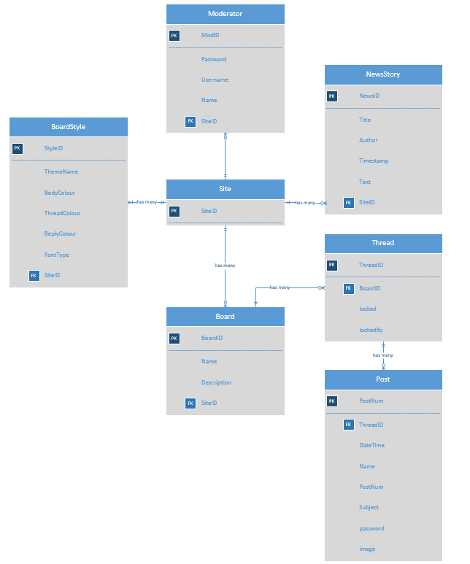
Entity relationship diagram 2
This is what the ERD would look like if my system had everything implemented (could have and should have features from MoSCoW)
I’m not sure how many of these things will be in the final product however none of the features or tables are dependent on each other apart from moderators being needed for news stories and for deleting posts. So this will be given greater priority during development.

Slide 21
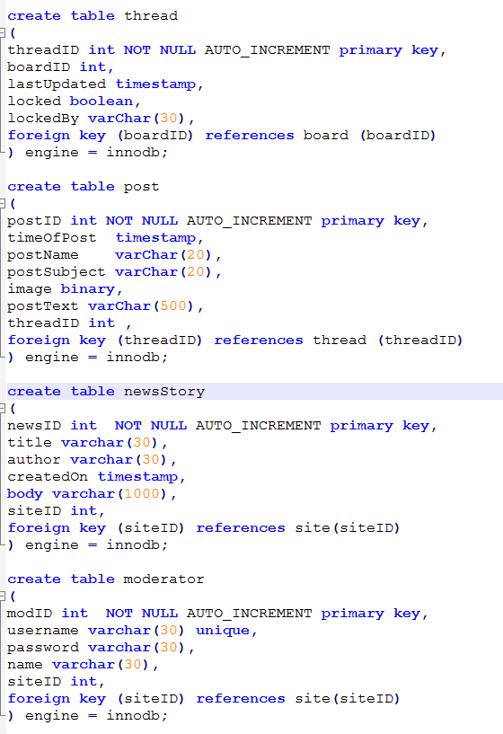
Creating the sql Database
To the left is how I have created some of my database. I am using auto incrementing and unique IDs as primary keys for every entity in my database to keep it simple.

Slide 22
SQL QUERY insert
This is an example of an insert query in my DB it is for a new post being added
In the 2nd thread the user posted with no subject and “hi” in the name field he did not upload an image and had “SAMMPLE TEEEEEEEEEXT” as the body of text. postID and the time it is posted are auto created by the database
WOW

Slide 23
SQL QUERY change
This is an example of a change query that will be used in my DB
The board id will be loaded onto the page before the changes are submitted so the id is known by the page and the user. After the boardID had been selected and the description has been changed by a signed in moderator a query like the one above is sent to the DB

Slide 24
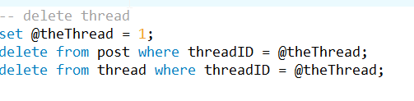
SQL QUERY Delete
This is the subroutine in MySQL that runs when you want to delete a thread I have yet to learn how I can set a variable like this in a subroutine and I might end up just sending two separate statements to the server either way its not too hard to delete a thread.

Slide 25

SQL simple QUERY
This is the very simple table that returns the information of every post in a thread. In this case that thread is thread 2.

Slide 26
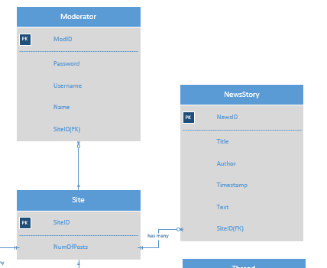
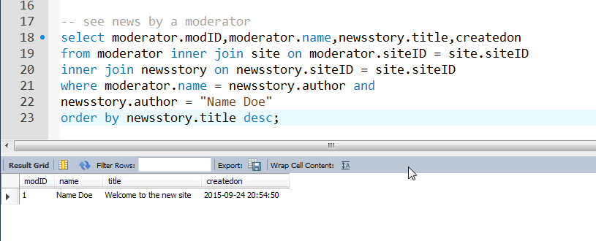
SQL complex QUERY
This is a query that shows all the news stories created by a certain moderator. I was thinking that clicking on the authors name on the article could lead to a page with their name and other articles with dates of creation.
Excerpt from my ERD showing the relationship between these tables.

Slide 27
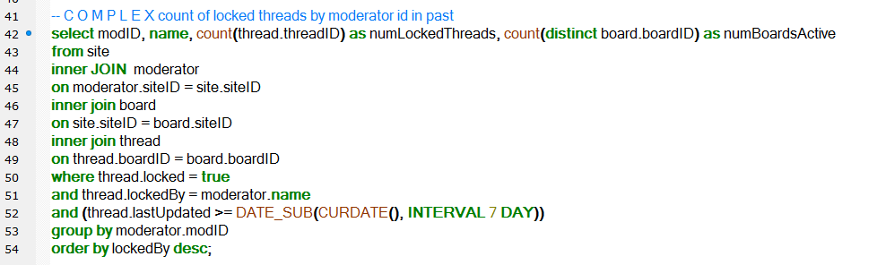

Super complex query
This is a query that counts the amount of threads that a moderator has locked and the number of boards they have locked threads on but only for threads locked in the past week(7 days) ordered by modID.

Slide 28
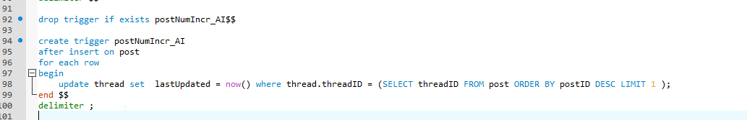
Other SQL fun
In order to be able to display the threads in the order of most recently posted in there is a trigger in the database that updates a timestamp called lastUpdated on the thread it was posted to. Anytime a new post is made a thread gets updated with the current timestamp.

Slide 29
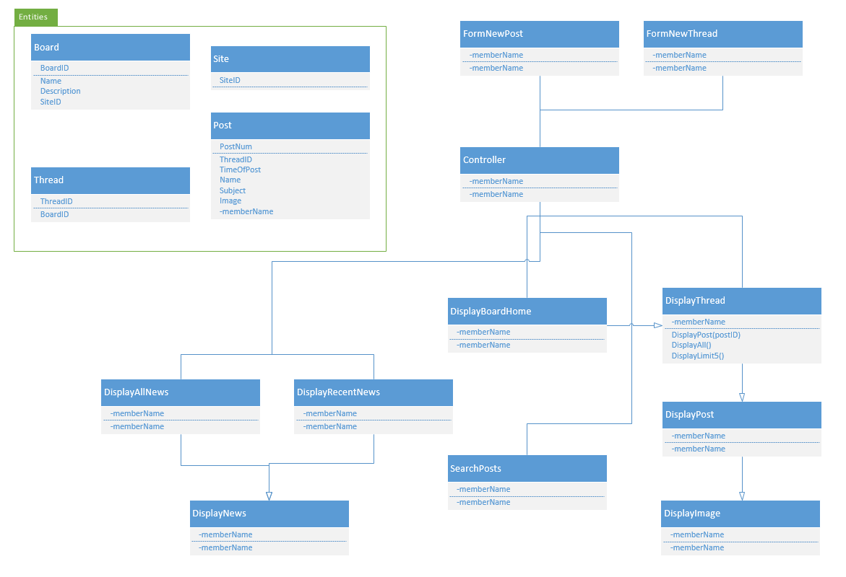
Class diagram
This is my class diagram of what the class structure and interaction will be like

Slide 30

Could this design work for the Maori learning app
Yes! Both Theseus & Minotaur and MLA could exist on the same site in different boards offering support for both at the same time If you wanted. The design is generic enough that you could easily cater to whatever topics and hobbies you wanted to.

Slide 31

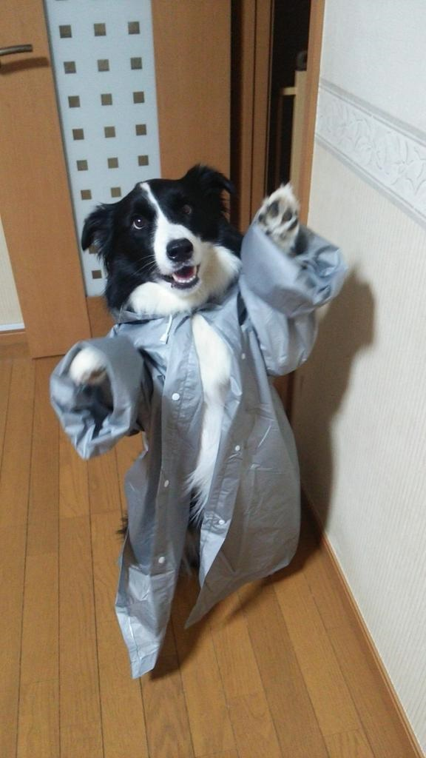
Dog

